Slide 1
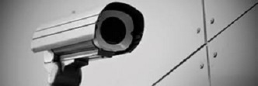
Home Security
(A Web Based Camera Application)

Slide 2
WHAT IS HOME SECURITY?
Home Security is a security application that will protect your private and valuable documents in your absence.
It is a web based camera application that uses a technology called Computer Vision.
It is written purely in java which makes it platform independent.
It has two modules-
1. A web application that is deployed on cloud.
2. A core application that will run onto a local computer where the camera is installed.

Slide 3
Why Home Security?
Today the crime rate is exceeding day by day and in this competitive world, security is one of the major concerns.
We need a security master that will help us in taking care of our private and valuable things in our absence. It will help you to keep your home, important place and document protected.
We understand you and your tensions regarding your home and valuable documents in your absence, so we made this application that will help you to reduce your headache regarding your private important document and hard working penny.
Home Security is one of that security masters that will not let you and your family unsecured. It will protect your family and your important document and property from theft and illegal access by keeping an eye on them.

Slide 4
Features Of Home Security?
One Can access the settings of camera from any part of the world through internet.
You can start the detection mode from the core desktop application or from the web application.
The detection mode triggers various events in case of any motion.
You can get alerts when there is motion in front of camera.
View the captured images online through web application.
Register mobile numbers on to which you want to get alerts during detection.

Slide 5
About Home Security Web Application.
The web application is designed in HTML, Bootstrap and Javascript with JSP as core of all that made it all working.
You can access the web application through a URL which is https://securehome.mybluemix.net.
You can make your user account here to start using the application.
You can purchase various services according to your need online.
You can change your settings any time.

Slide 6
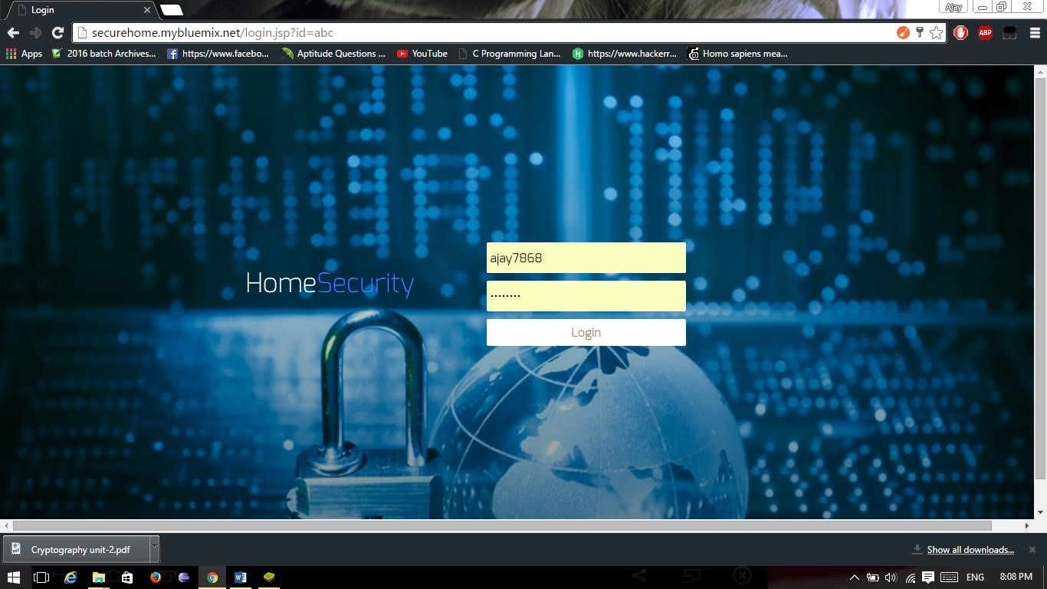
Web Application Login Page…

Slide 7
Web Application Signup Page…

Slide 8
Web Application Services page…

Slide 9
About Core Application…
The core application is totally written in java.
It has used java FX for its GUI and core java for its working.
It has used Open CV API code for its camera module.
Being Written in java, it is platform independent.
You can Login your account to start monitoring.

Slide 10
Core Application View…

Slide 11
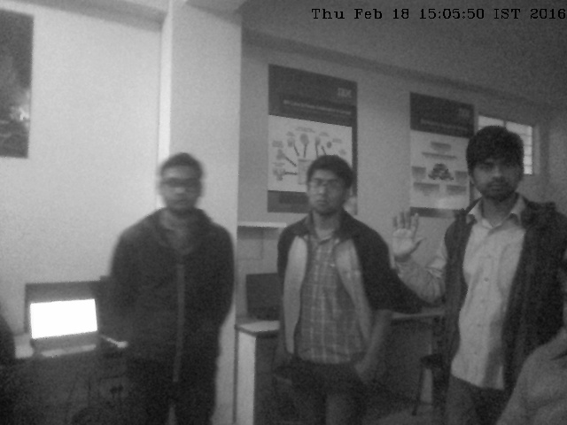
Detected Image from Core Application

Slide 12
Working Of Home Security.
You have to register yourself on the web application for getting a username and password.
After getting the username and password you can download the core application setup file from the website.
After downloading the core application from the website launch it by double clicking on it. A window will open up which will ask your username and password.
Enter your username and password to start the camera and other monitoring services. The detection mode then can be enabled by the website.
When there will be any motion during detection mode it will capture images and will store it on the web server where you can view all detected images with date and time though the website by just logging into your account. Also during detection, you will get an alert that there is an illegal activity with the date and time of detection in the message.

Slide 13
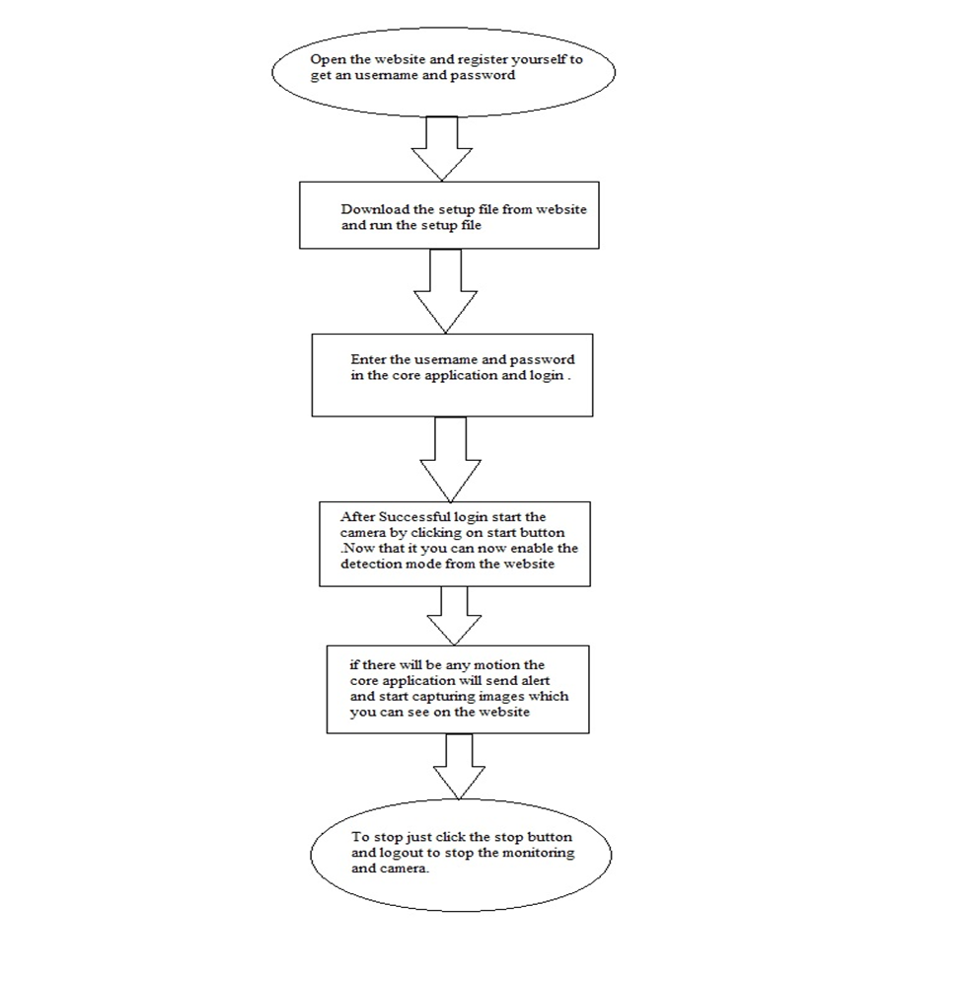
Working (continued)

Slide 14
Hardware Requirements For Running The application…
RAM : Min 1 GB
Hard Disk Space : 40 GB
Processor : Pentium 4 (or higher) or equivalent AMD
Screen Resolution :1024 x 768
Digital Camera with a good resolution .

Slide 15
Software Requirements For Running The application…
Operating System : Windows 7 (or later)
Java Virtual Environment
Open CV 3.0.0
Camera Compatible Drivers

Slide 16
Additional Setting For Setup Purpose..
Install Open CV 3.0.0 which can be downloaded from GitHub website.
Set the path of open CV in the System Environment Variable where you have installed the Open CV as (installed directory/build/x64 or x86/vc11 or vc12/bin).
Install Java Development Kit.
For Linux based OS, instead of downloading and running exe file run jar file through terminal.

Slide 17
Conclusion
Home Security is a hybrid web application that will monitor and detect images in case of any motion detected.
It will send alert to your registered mobile number and upload the detected images on to the web server which can be viewed on the web application. So Home Security is one of the powerful application that will help in detecting theft and restrict it by happening.
It will not only decrease the theft rate but also help in gathering theft information.
Thus Home Security is a must have application for every home and office so that you and your family can have a better sleep and better future for tomorrow.

Slide 18
Presented By
Ajay Kumar (1206810016)
Gaurav Samant (1206810087)
Kaushal Kumar (1206810102)
Shashank Bharadwaj (1206810200)
Thanking You

